Slide 1

Build GUIs to make your code look super expensive
Merlijn Van Waeyenberghe

Slide 2

Topics
What?
Why?
How?
Notes:
Check out the groovy 3D model transitions ;)

Slide 3
What is a GUI?
From Wikipedia:
The graphical user interface (GUI /ˈɡuːi/) is a form of user interface that allows users to interact with electronic devices through graphical icons and visual indicators such as secondary notation, instead of text-based user interfaces, typed command labels or text navigation.
GUIs were introduced in reaction to the perceived steep learning curve of command-line interfaces (CLIs), which require commands to be typed on a computer keyboard.
Notes:
Many system admins still prefer a GUI over a CLI. Reasons:
Knowledge
Fear of the unknown
Worried to break things
Think how many Windows Server installations are still with GUI, increasing attack surface, maintenance overhead (patching) and increasing footprint.
PowerShell has become mainstream but many still want to SEE what’s happening.

Slide 4
What is a PowerShell GUI?
Built on Windows Presentation Foundation
XML-based language
Interpreted by .NET Extensible Application Markup Language (XAML) reader
UI Framework
"You write the markup, I write the code“
– Your Compiler

Slide 5
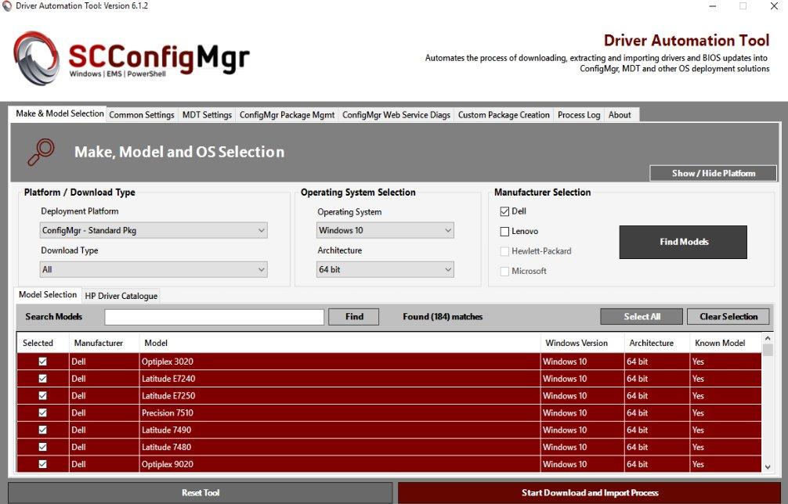
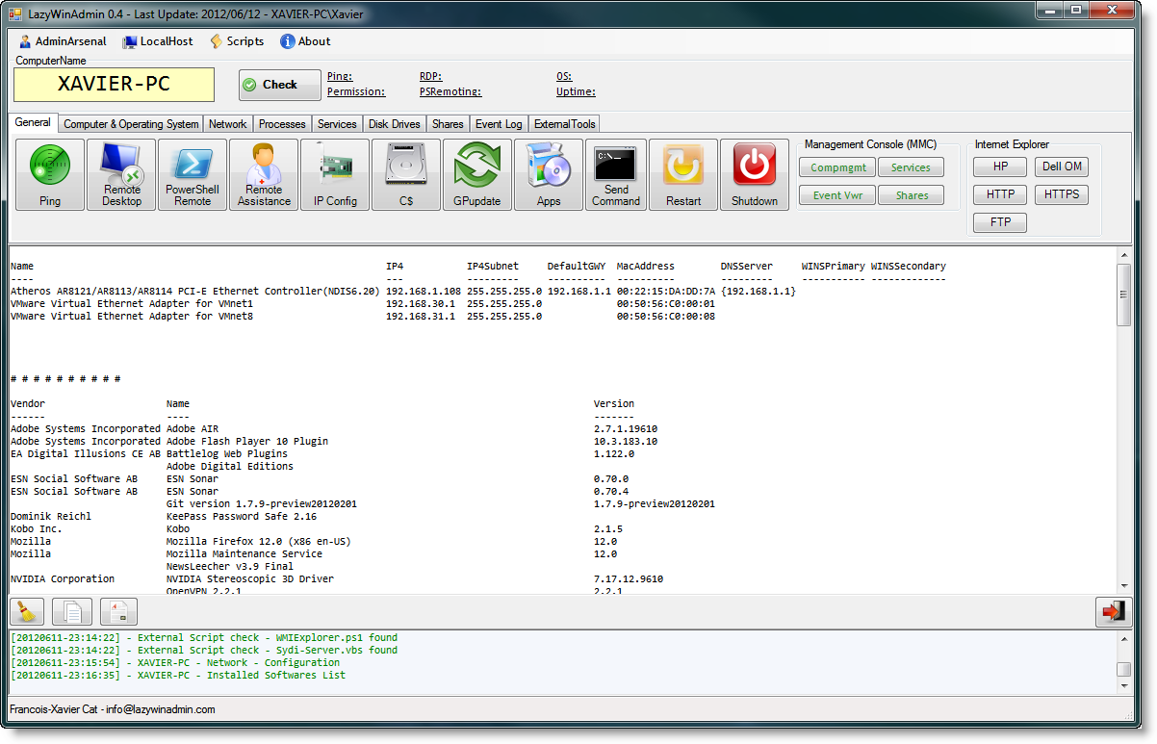
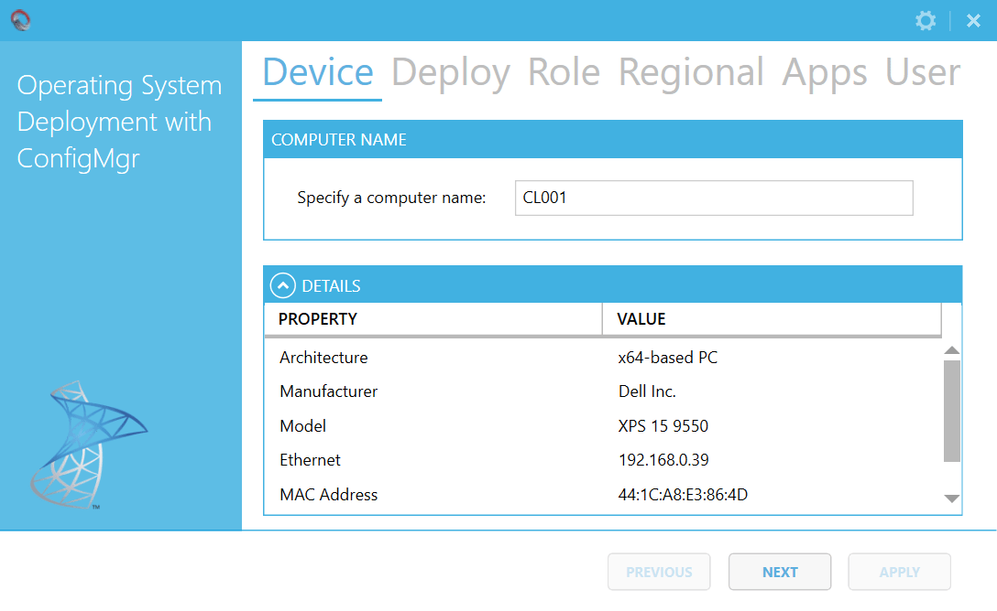
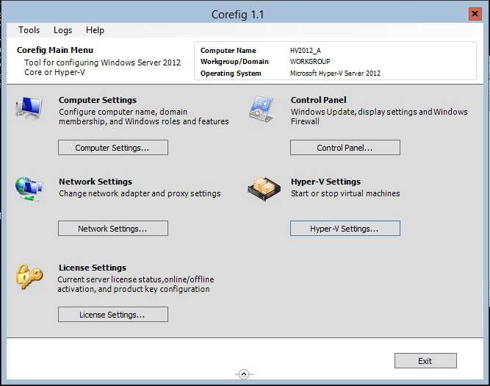
Some PowerShell GUI examples
Notes:
Here are some well-known (or little-known) examples of PowerShell-based GUIs, either using WinForm or XAML.
Corefig to manage Hyper-V hosts
LazyWinAdmin, a remote management tool for Windows machines
Driver (and BIOS) Automation Tool by Maurice Daly
OSDFrontEnd for ConfigMgr by Nickolaj Andersen
Note on Server Core: officially, WPF is not supported but some GUI applications work
Source: https://social.msdn.microsoft.com/Forums/en-US/7dfc09a3-b6fd-4c94-8d96-68e246f068aa/windows-2008-core-and-wpf?forum=wpf

Slide 6
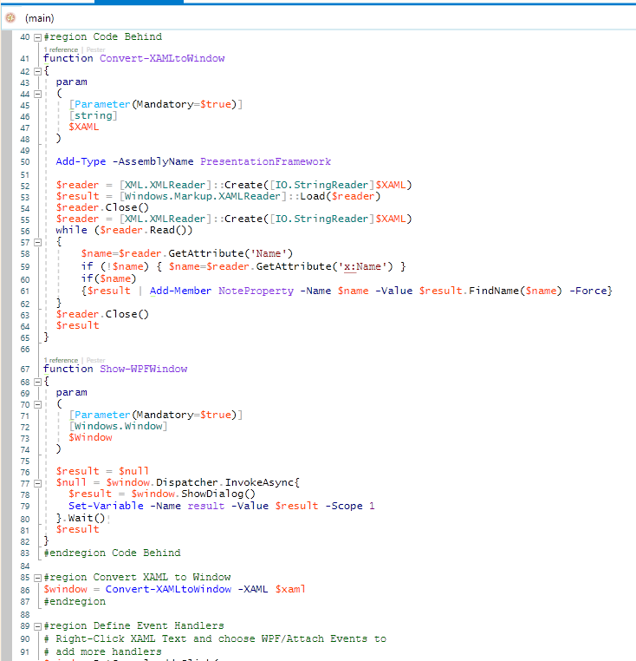
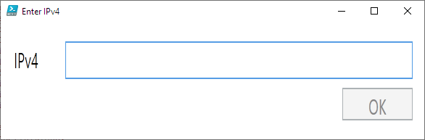
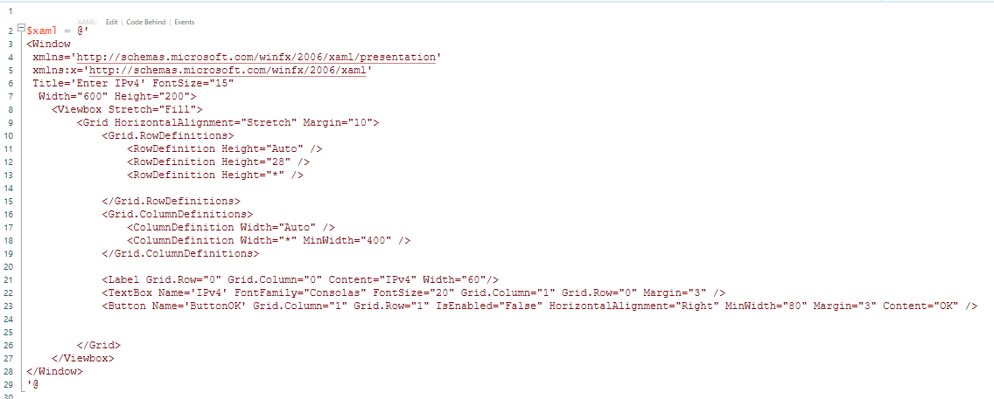
What is XAML?
XML-style markup language
Specific to .NET object-based applications
Makes it easy to “write” a UI
Notes:
XAML as implemented by WPF. XAML itself is a larger language concept than WPF.
What is XAML?
XAML is a declarative markup language. As applied to the .NET Framework programming model, XAML simplifies creating a UI for a .NET Framework application. You can create visible UI elements in the declarative XAML markup, and then separate the UI definition from the run-time logic by using code-behind files, joined to the markup through partial class definitions.
When represented as text, XAML files are XML files that generally have the .xaml extension. The files can be encoded by any XML encoding, but encoding as UTF-8 is typical.
You could WRITE XAML but it’s much like writing HTML: you really need to know your syntax.
It’s not WYSIWYG
The example code shows a simple text box, an input field and a button to verify that the entered string matches a proper IPv4 format, using the .NET IPAddress object (code behind)
See ISESteroids > WPF Samples > Validate input

Slide 7


Why create a GUI?
Make it a tool to share
Embrace the mouse-click
Visualize parameters
Company branding
Because why not!?
Notes:
Your code becomes more shareable. It will be easier to adopt by others, especially those without much PS experience.
Many people will still prefer clicking over typing.
No matter how well-written your code, most people won’t read it to figure out how to use it.
My experience:
[Optional parameters] are misinterpreted
Parameter sets are too advanced
Replace filename parameters with Browse button
Use date and time pickers
Use input fields for strings and integers
Check boxes for optional params
Radio buttons for switch params
Dropdown boxes for pre-populated params

Slide 8
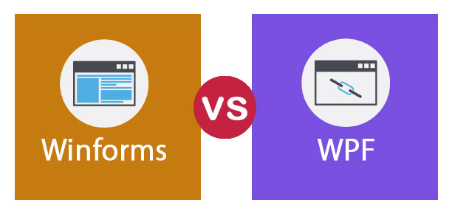
Why WPF and XAML?
Why not WinForm?
WinForm advantages
It's older and thereby more tried and tested
There are already a lot of 3rd party controls that you can buy or get for free
The designer in Visual Studio is still, as of writing, better for WinForms than for WPF, where you will have to do more of the work yourself with WPF
Source
Notes:
Each their own, but WinForm has a much more verbose style of defining elements of a form.
XAML is inspired by CSS. It uses C# to cover the background magic (code-behind).
XAML is not exclusive to PowerShell! But PS is our favourite language ☺
Best to read up on the pros and contras yourself. I’m no developer.
“…where you will have to do more of the work yourself with WPF” Really?
Reference:
https://stackoverflow.com/questions/31154338/windows-forms-vs-wpf
https://www.wpf-tutorial.com/about-wpf/wpf-vs-winforms/

Slide 9
How do we do this already?
How to write/edit XAML?
Pick your weapon of choice
Visual Studio (Code, Community, …)
PowerShell ISE
Recommended: ISESteroids by Tobias Weltner
http://www.powertheshell.com/
Kaxaml is like Notepad for XAML
https://github.com/punker76/kaxaml/releases
Notes:
Visual Studio is the norm, probably. Any version will do.
I personally still prefer the PowerShell ISE, for one big reason: ISESteroids. It has helped me write better code throughout the years and you should check it out. (I will not actively promote the purchase of this or any product)
Kaxaml is another great free tool to help you write XAML. Development has been discontinued, but there is at least one active fork of it on Github with some great additional features.

Slide 10
How do we add code?
By default, the new WPF application contains a Window with a Grid panel. In this procedure you add four rows and four columns to the grid. You set the width of each column to *, so that the available width is divided evenly among the four columns. You set the height of three of the rows to Auto, so that they are sized to fit their content. You set the height of one of the rows to *, so that it uses the remaining available height.
To add a panel control
In Design view, select the grid.
(Optional) In the Properties window, locate the ShowGridLines property and select the check box.
When the application runs, the gridlines will appear on the window. This is useful for debugging, but you should clear the ShowGridLines property check box for production code.
In the Properties window, locate the ColumnDefinitions property, and click the ellipsis button in the property value column.
The Collection Editor dialog box appears.
Click Add four times to add four columns.
Set the Width property of the first row to Auto.
Set the Width property of the second row to *.
Set the Width property of the third row to Auto.
Set the Width property of the fourth row to Auto.
Click OK to close the Collection Editor and return to the WPF Designer.
Now there are four columns in the grid, but only one column appears. The columns whose Width properties are set to Auto are temporarily hidden because they do not have any content. For this walkthrough, that is fine. To avoid this in the future, you can use star sizing while you work, and change to Auto when you are done.
In the Properties window, locate the RowDefinitions property, and click the ellipsis button in the property value column.
The Collection Editor dialog box appears.
Click Add four times to add four rows.
Set the Height property of the first row to Auto.
Set the Height property of the second row to Auto.
Set the Height property of the third row to *.
Set the Height property of the fourth row to Auto.
Click OK to close the Collection Editor and return to the WPF Designer.
Now there are four rows in the grid, but only one row appears. The rows whose Height properties are set to Auto are temporarily hidden because they do not have any content. For this walkthrough, that is fine. To avoid this in the future, you can use star sizing while you work, and change to Auto when you are done.
On the File menu, click Save All.
Adding Controls to the Panel
Next you add controls to the panel and use the Column and Row attached properties of the Grid to position them dynamically.
To add controls to the panel
From the Toolbox, in the Common group, drag a Label control onto the Grid.
In the Properties window, set the following properties for the Label:
Property
Value
Content
Name:
Grid.Column
0
Grid.ColumnSpan
1
Grid.Row
0
Grid.RowSpan
1
Width
Auto
Height
23
HorizontalAlignment
Stretch
VerticalAlignment
Top
Margin
20,20,10,10
From the Toolbox, in the Common group, drag a Label control onto the Grid.
In the Properties window, set the following properties for the Label:
Property
Value
Content
Password:
Grid.Column
0
Grid.ColumnSpan
1
Grid.Row
1
Grid.RowSpan
1
Width
Auto
Height
23
HorizontalAlignment
Stretch
VerticalAlignment
Top
Margin
20,10,10,10
From the Toolbox, in the Common group, drag a TextBox control onto the Grid.
In the Properties window, set the following properties for the TextBox:
Property
Value
Grid.Column
1
Grid.ColumnSpan
3
Grid.Row
0
Grid.RowSpan
1
Width
Auto
Height
Auto
HorizontalAlignment
Stretch
VerticalAlignment
Stretch
Margin
10,20,20,10
From the Toolbox, in the Common group, drag a TextBox control onto the Grid.
In the Properties window, set the following properties for the TextBox:
Property
Value
Grid.Column
1
Grid.ColumnSpan
3
Grid.Row
1
Grid.RowSpan
1
Width
Auto
Height
Auto
HorizontalAlignment
Stretch
VerticalAlignment
Stretch
Margin
10,10,20,10
From the Toolbox, in the Common group, drag a Button control onto the Grid.
In the Properties window, set the following properties for the Button:
Property
Value
Content
OK
Grid.Column
2
Grid.ColumnSpan
1
Grid.Row
3
Grid.RowSpan
1
Width
75
Height
23
HorizontalAlignment
Stretch
VerticalAlignment
Stretch
Margin
10,10,6,20
From the Toolbox, in the Common group, drag a Button control onto the Grid.
In the Properties window, set the following properties for the Button:
Property
Value
Content
Cancel
Grid.Column
3
Grid.ColumnSpan
1
Grid.Row
3
Grid.RowSpan
1
Width
75
Height
23
HorizontalAlignment
Stretch
VerticalAlignment
Stretch
Margin
6,10,20,20
On the File menu, click Save All.
Testing the Layout
Finally you run the application and verify that the layout changes dynamically as the user resizes the window, and as the content of the controls expands beyond the size of the controls.
To test the layout
On the Debug menu, click Start Debugging.
The application starts and the window appears.
In the Name text box, type randomly to fill the text box. When you reach the end of the text box, both the text box and the window expand to fit the text that you type.
Close the window.
On the Debug menu, click Start Debugging.
The application starts and the window appears.
Resize the window both vertically and horizontally.
The columns expand evenly to use the available space. The text boxes stretch to fill the expanded columns. Three rows maintain their height, and the fourth row expands to use the available space.
Close the window.
In Design view, select the Name label.
In the Properties window, change the Content property to Please enter your full name here:.
In Design view, the label expands to fit the text.
On the Debug menu, click Start Debugging.
The application starts and the window appears. The label control displays the longer text.
Close the window.
Notes:
Keep scrolling… ;)

Slide 11

How about we just do some demos?!
Notes:
Basically, a WPF form has 3 portions:
XAML code
Event handlers
Code-behind

Slide 12
References to help you along
https://foxdeploy.com/series/learning-gui-toolmaking-series/
https://wpf-tutorial.com/
https://docs.microsoft.com/en-us/dotnet/framework/wpf/getting-started/wpf-walkthroughs
https://powertheshell.com (ISESteroids Module)

Slide 13
Q&A

